Slide 1




Areal data modelling
C. Edson Utazi
October 2026

Slide 2
Learning objectives
By the end of this session, you will be able to:
Describe areal data and distinguish them from other types of spatial data.
Explain how spatial dependence is represented and characterised in areal data.
Describe commonly used areal data models.
Explain and differentiate conditional autoregressive (CAR) models for modelling spatial and spatiotemporal dependence in areal data.
Apply spatial and spatiotemporal areal data models to real-world disease data using R-INLA.
Interpret model outputs and assess spatial patterns and uncertainty in estimated disease risk.

Slide 3
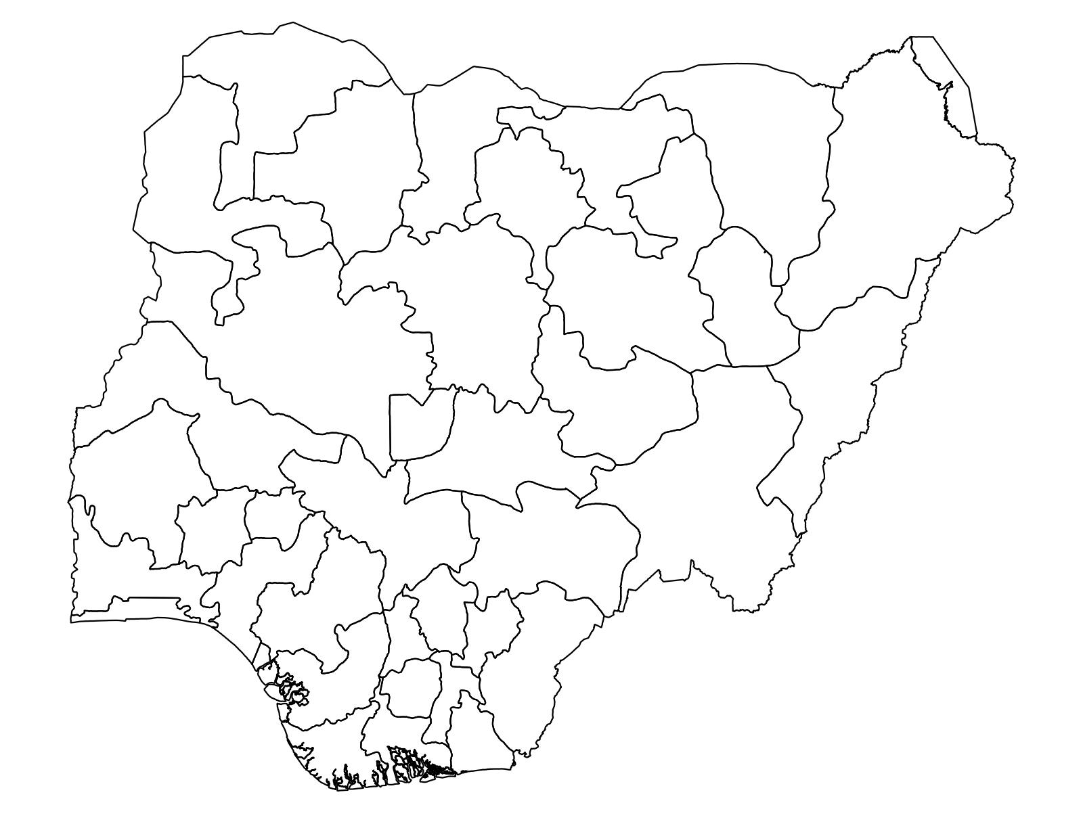
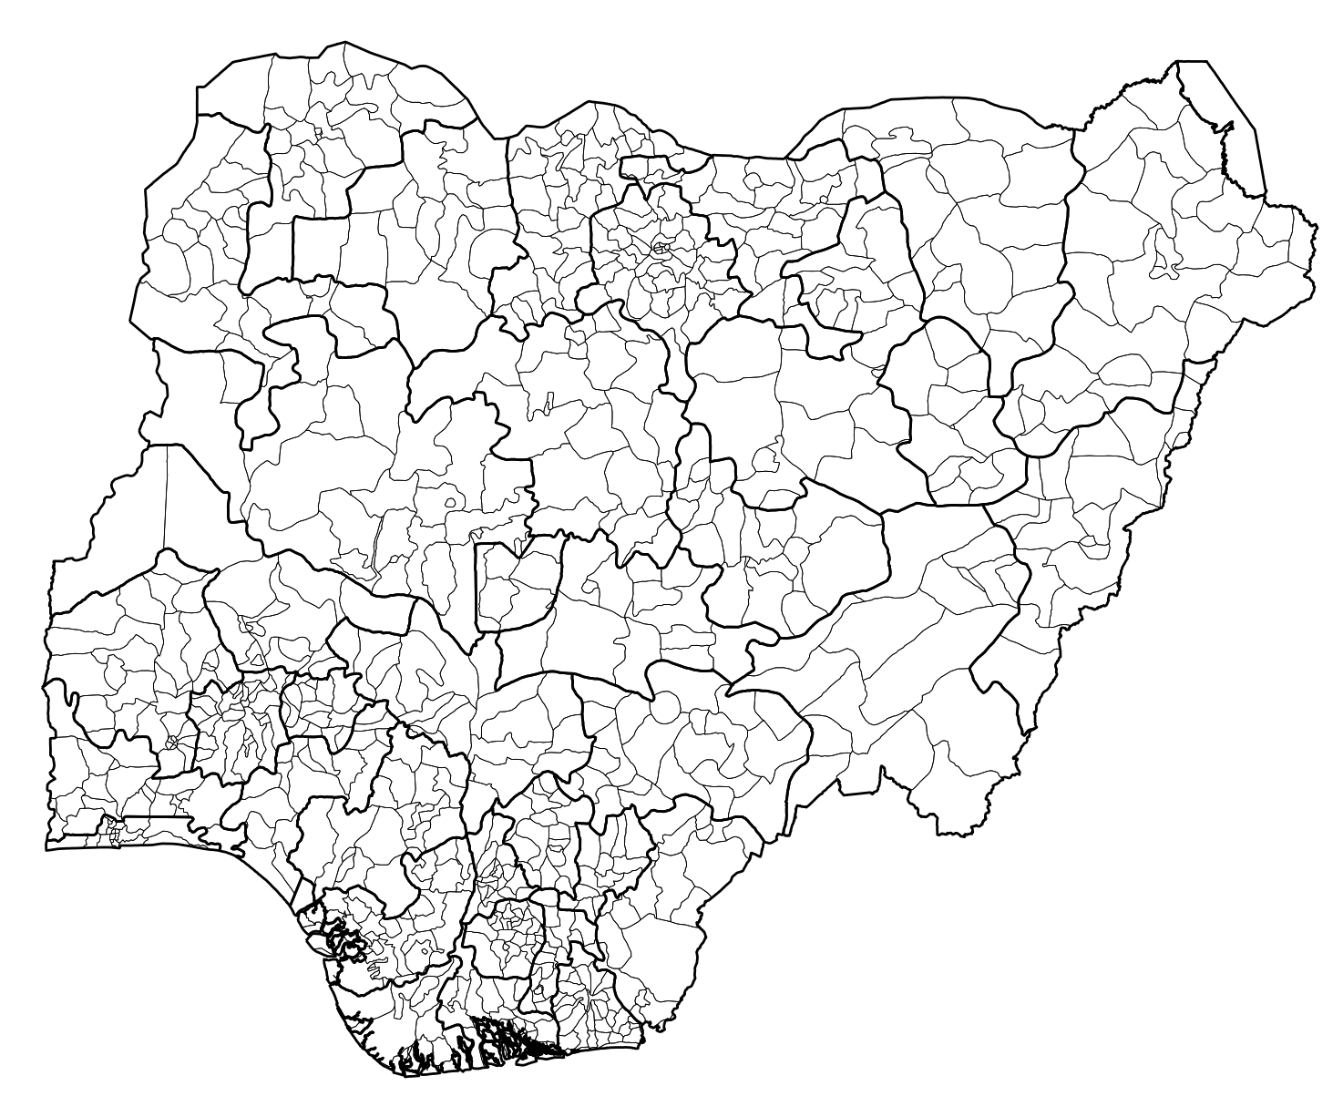
Introduction
Compared to point-referenced data, areal data observed on a discrete set of spatially referenced entities, e.g., administrative level 1 areas in a country, require different analytical approaches
The discrete spatial domain changes how we define spatial association
Also, the observed response variable is often a count variable, which would warrant the use of generalized linear models in the analysis
shapefile

Slide 4
Introduction
Areal data models are particularly useful in disease mapping studies, where the objective is to map the spatial pattern in disease risk over a given study region
Similar to models for point-referenced data, we will use Bayesian hierarchical models to analyze areal data
These models model spatial dependence in the data using random effects, which are represented using conditional autoregressive (CAR) models – a type of (G)MRF.

Slide 5
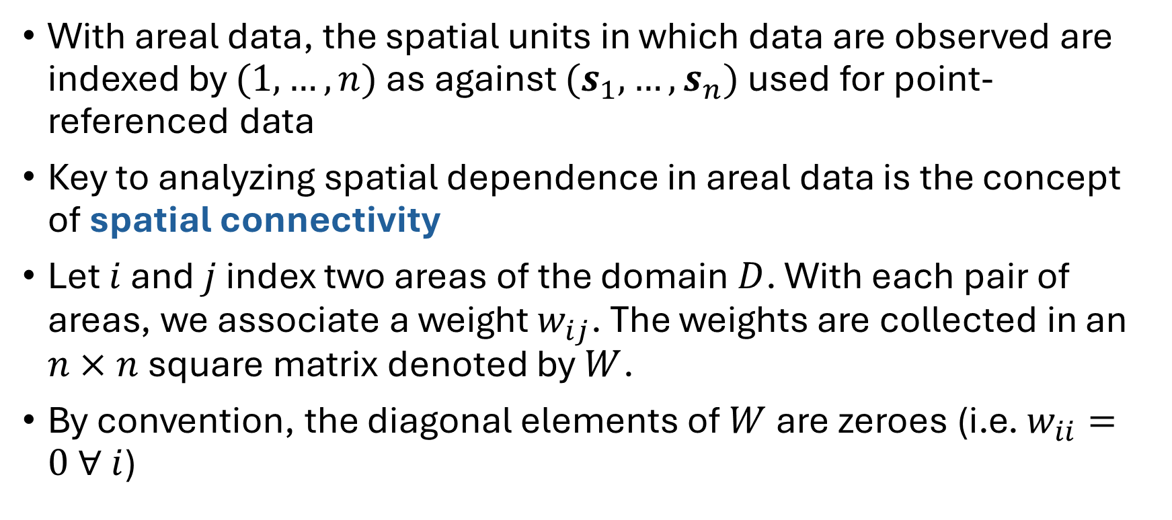
Defining spatial dependence with areal data
With areal data, the spatial units in which data are observed are indexed by $(1,…,n)$ as against $(s_{1},…, s_{n})$ used for point-referenced data
Key to analyzing spatial dependence in areal data is the concept of spatial connectivity
Let $i$ and $j$ index two areas of the domain $D$. With each pair of areas, we associate a weight $w_{ij}$. The weights are collected in an $n×n$ square matrix denoted by $W$.
By convention, the diagonal elements of $W$ are zeroes (i.e. $w_{ii}=0 ∀ i$)

Slide 6
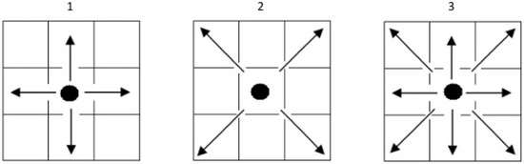
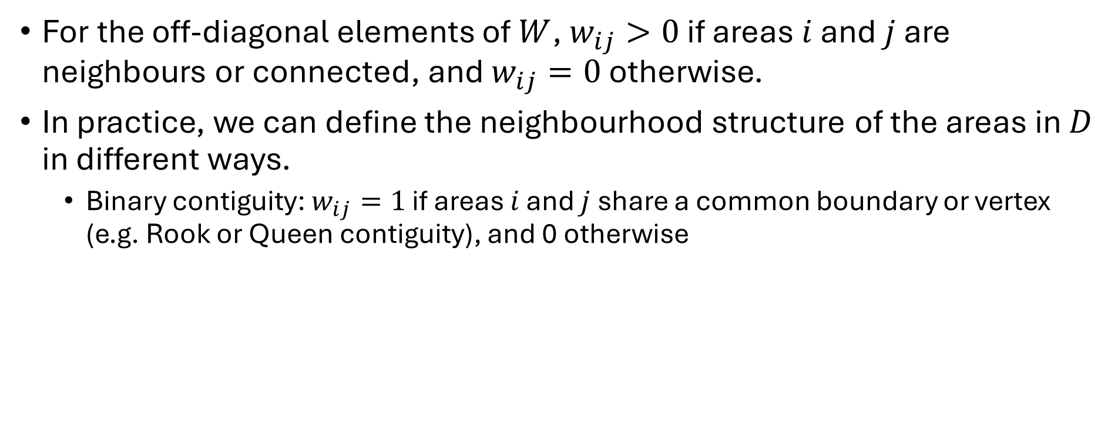

Defining spatial dependence with areal data
For the off-diagonal elements of $W$, $w_{ij}>0$ if areas $i$ and $j$ are neighbours or connected, and $w_{ij}=0$ otherwise.
In practice, we can define the neighbourhood structure of the areas in $D$ in different ways.
  Binary contiguity: $w_{ij}=1$ if areas $i$ and $j$ share a common boundary or vertex (e.g. Rook or Queen contiguity), and 0 otherwise
1. Rook contiguity 2. Bishop 3. Queen
Black dot is area $i$ and $w_{ij}=1$ for the areas the arrows point to.
Named after chess moves: a rook moves along rows/columns only; a queen also moves diagonally.

Slide 7
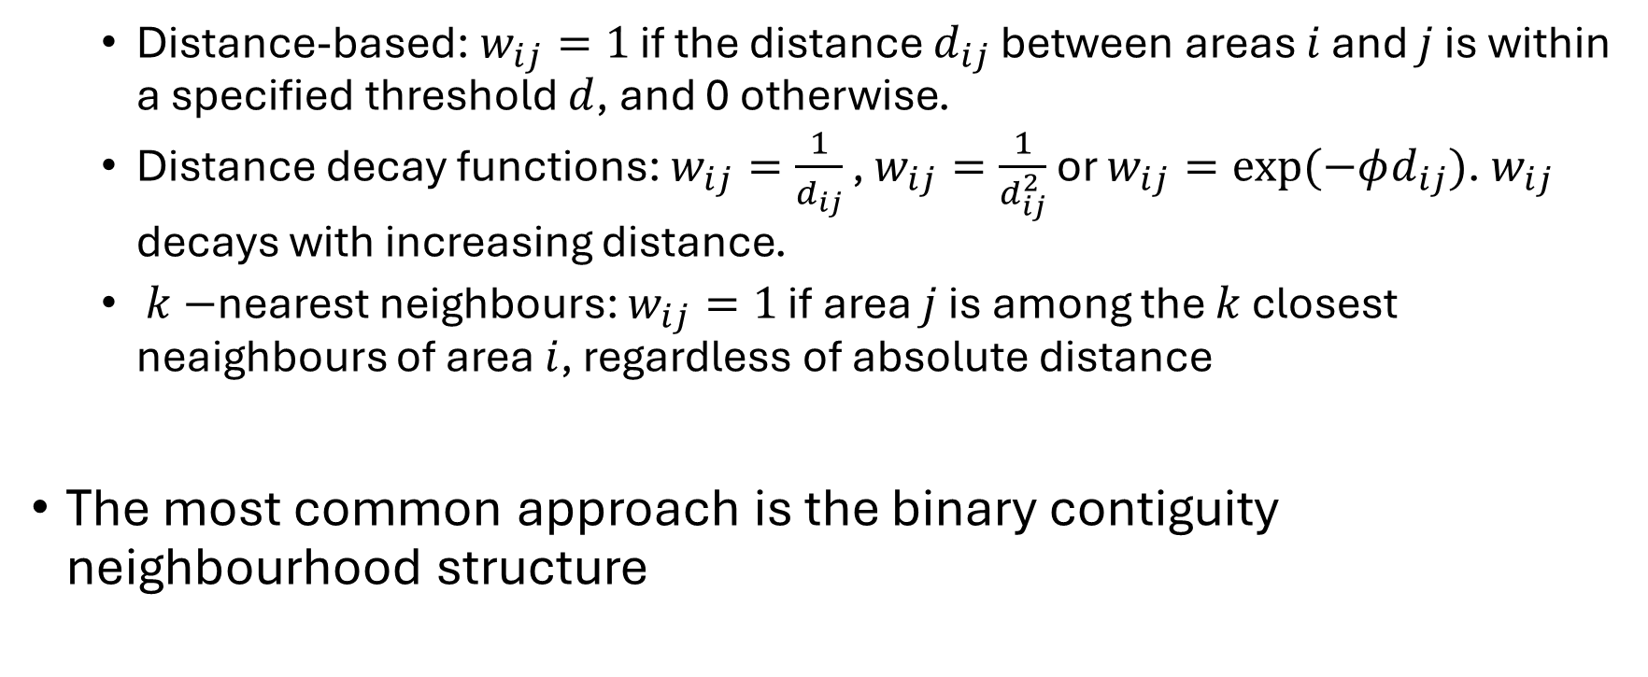
Defining spatial dependence with areal data
  Distance-based: $w_{ij}=1$ if the distance $d_{ij}$ between areas $i$ and $j$ is within a specified threshold $d$, and 0 otherwise.
  Distance decay functions: $w_{ij}=\frac{1}{d_{ij}}$ , $w_{ij}=\frac{1}{d_{ij}^{2}}$ or $w_{ij}=exp⁡(−φd_{ij})$. $w_{ij}$ decays with increasing distance.
  $k−$nearest neighbours: $w_{ij}=1$ if area $j$ is among the $k$ closest neaighbours of area $i$, regardless of absolute distance
The most common approach is the binary contiguity neighbourhood structure

Slide 8
Common probability distributions used for areal data
Data type | Distribution | Typical example
Counts/Overdispersed counts | Poisson/Negative binomial | Number of disease cases in each district
Binary/binomial outcomes (Proportions / prevalence) | Binomial | Number of children with disease out of those surveyed
Continuous measurements | Gaussian (Normal) | Mean temperature, pollution level, socioeconomic index
Positive continuous data | Gamma | Disease incidence rate, rainfall, expenditure
Positive skewed data | Log-normal | Income, environmental concentrations
Multinomial categories | Multinomial | Population distributed among several disease-status categories

Slide 9
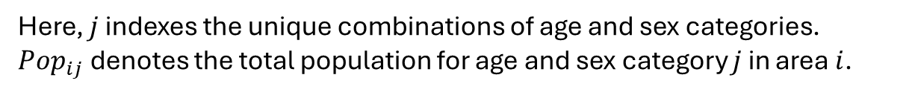
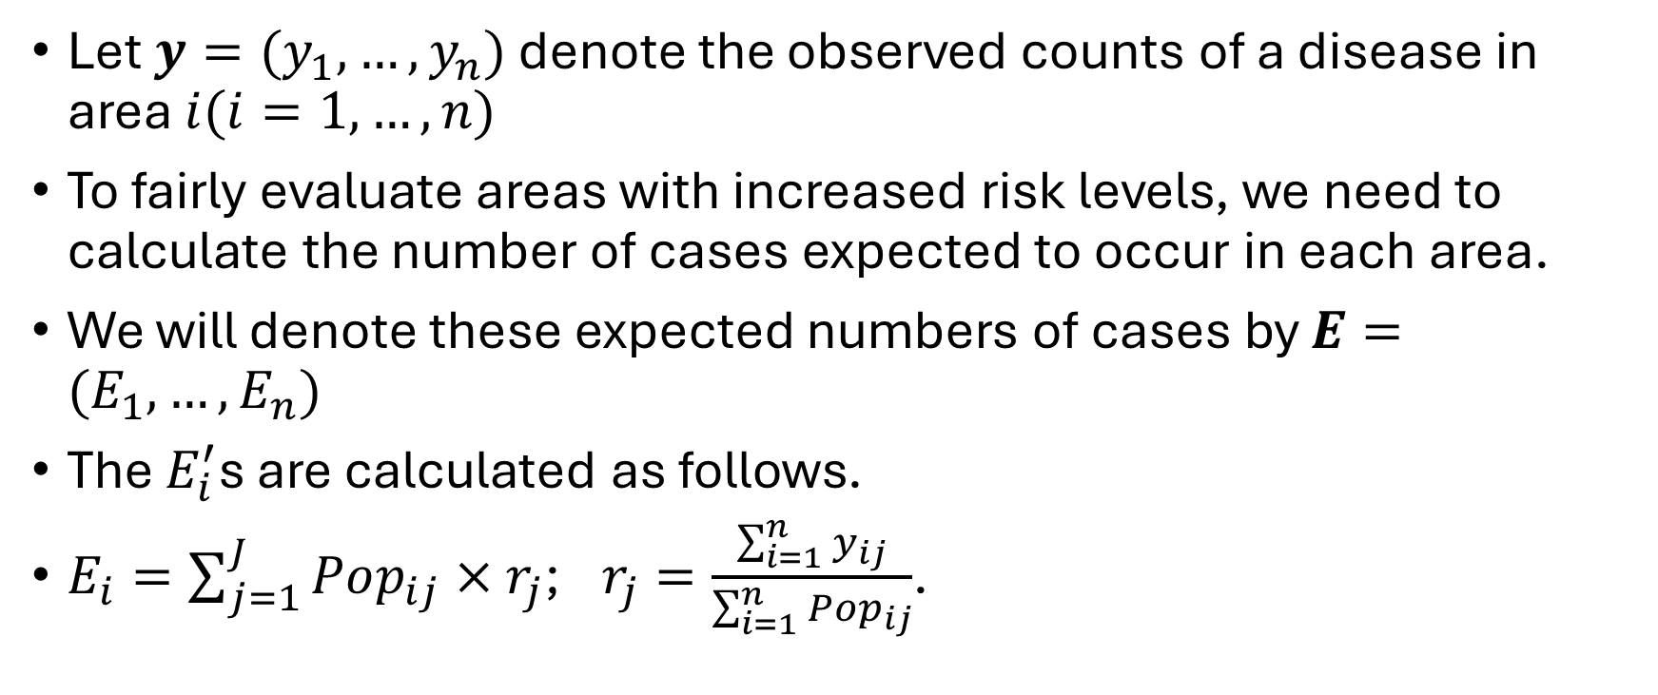
Area data models – disease mapping
Let $y=(y_{1},…,y_{n})$ denote the observed counts of a disease in area $i(i=1,…,n)$
To fairly evaluate areas with increased risk levels, we need to calculate the number of cases expected to occur in each area.
We will denote these expected numbers of cases by $E=(E_{1},…,E_{n})$
The $E_{i}^{′}$s are calculated as follows.
$E_{i}=\sum_{j=1}^{J}{Pop_{ij}×r_{j}}$; $r_{j}=\frac{\sum_{i=1}^{n}{y_{ij}}}{\sum_{i=1}^{n}{{Pop}_{ij}}}$.
Here, $j$ indexes the unique combinations of age and sex categories.
$Pop_{ij}$ denotes the total population for age and sex category $j$ in area $i$.

Slide 10
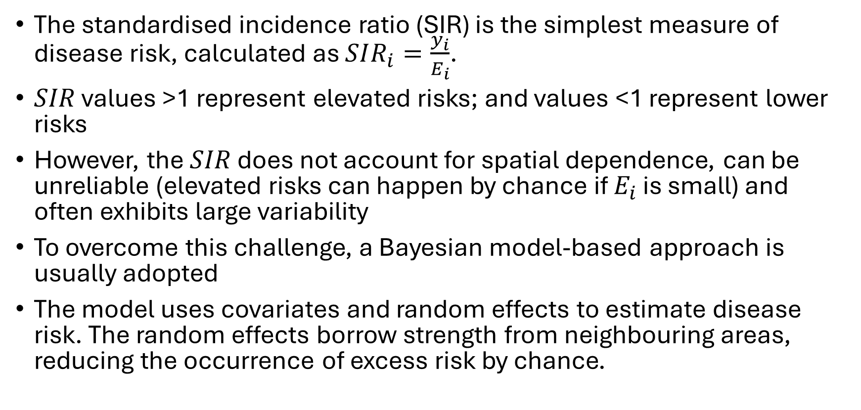
Area data models – disease mapping
The standardised incidence ratio (SIR) is the simplest measure of disease risk, calculated as $SIR_{i}=\frac{y_{i}}{E_{i}}$.
$SIR$ values >1 represent elevated risks; and values <1 represent lower risks
However, the $SIR$ does not account for spatial dependence, can be unreliable (elevated risks can happen by chance if $E_{i}$ is small) and often exhibits large variability
To overcome this challenge, a Bayesian model-based approach is usually adopted
The model uses covariates and random effects to estimate disease risk. The random effects borrow strength from neighbouring areas, reducing the occurrence of excess risk by chance.

Slide 11
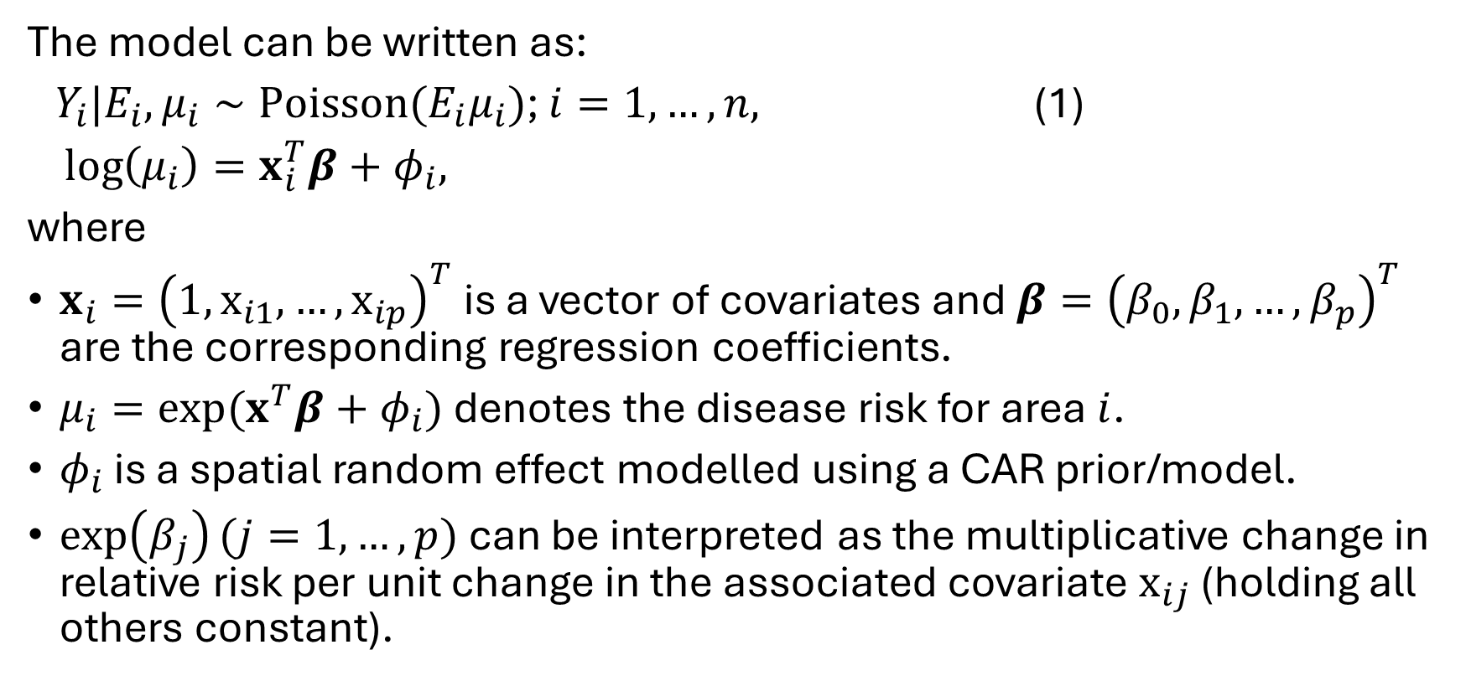
Area data models – disease mapping
The model can be written as:
$Y_{i}|E_{i},μ_{i}∼Poisson(E_{i}μ_{i})$; $i=1,…,n,$ (1)
$\log\left(μ_{i}\right)=x_{i}^{T}β+φ_{i},$
where
$x_{i}={\left(1,x_{i1},…,x_{ip}\right)}^{T}$ is a vector of covariates and $β={\left(β_{0},β_{1},…,β_{p}\right)}^{T}$ are the corresponding regression coefficients.
$μ_{i}=exp⁡(x^{T}β+φ_{i})$ denotes the disease risk for area $i$.
$φ_{i}$ is a spatial random effect modelled using a CAR prior/model.
$\exp\left(β_{j}\right)(j=1,…,p)$ can be interpreted as the multiplicative change in relative risk per unit change in the associated covariate $x_{ij}$ (holding all others constant).

Slide 12
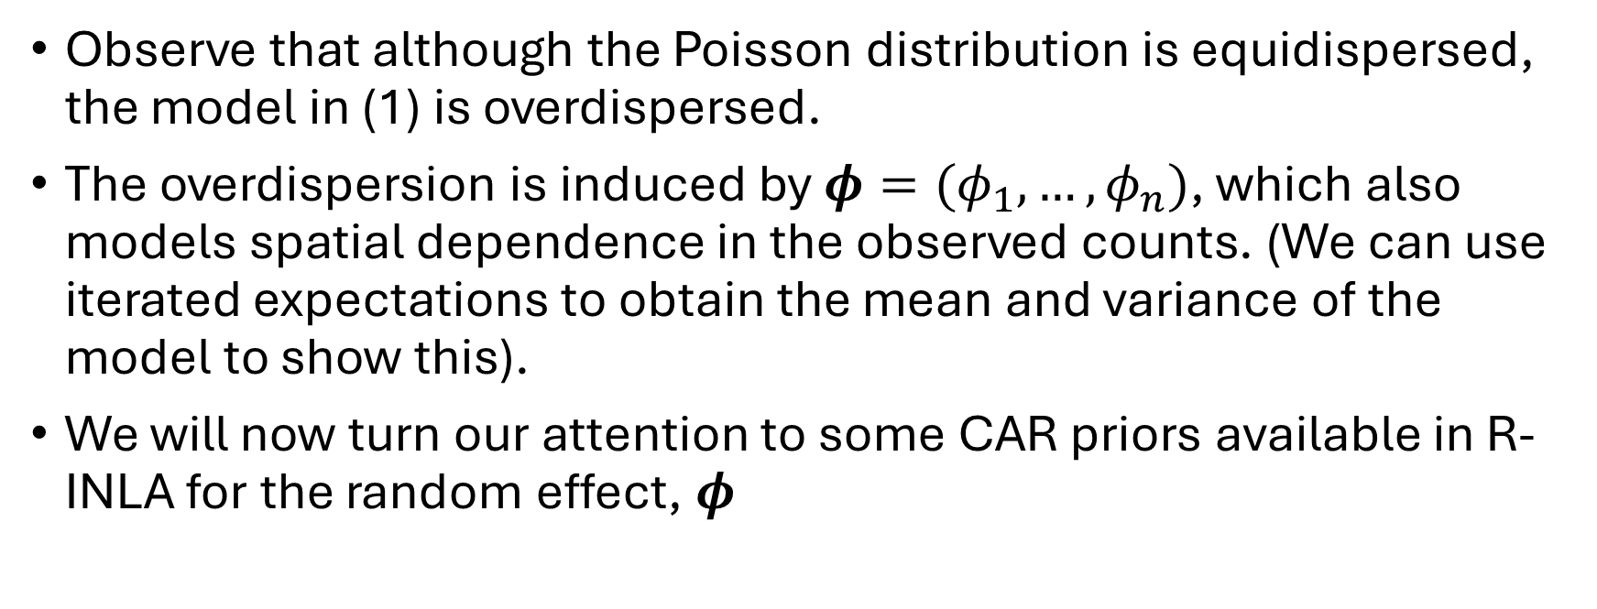
Area data models – disease mapping
Observe that although the Poisson distribution is equidispersed, the model in (1) is overdispersed.
The overdispersion is induced by $φ=(φ_{1},…,φ_{n})$, which also models spatial dependence in the observed counts. (We can use iterated expectations to obtain the mean and variance of the model to show this).
We will now turn our attention to some CAR priors available in R-INLA for the random effect, $φ$

Slide 13
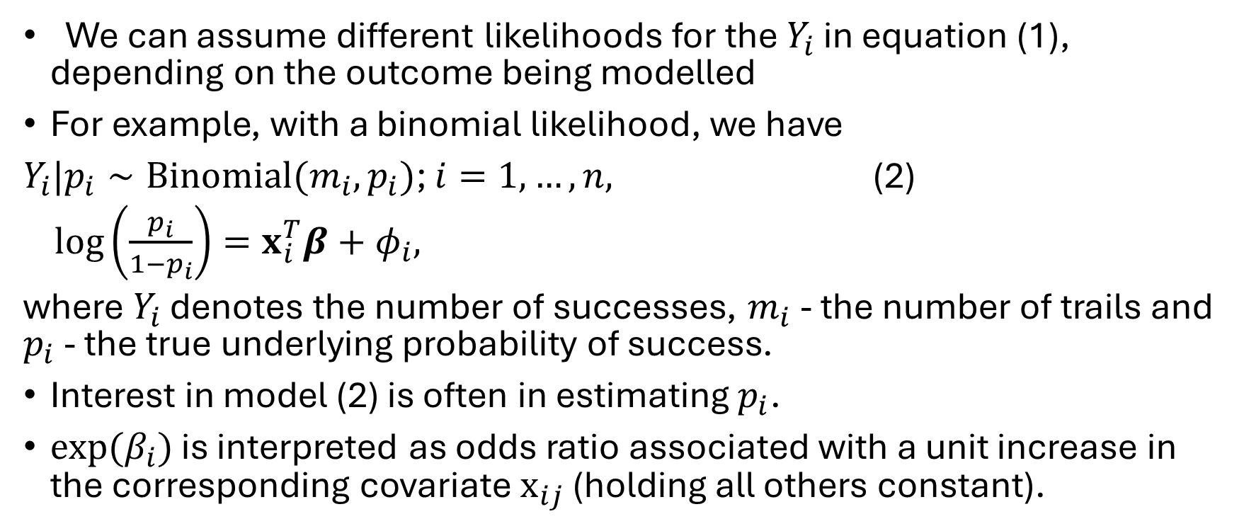
Binomial likelihood
Area data models – disease mapping
We can assume different likelihoods for the $Y_{i}$ in equation (1), depending on the outcome being modelled
For example, with a binomial likelihood, we have
$Y_{i}|p_{i}∼Binomial(m_{i}, p_{i})$; $i=1,…,n,$ (2)
$\log\left(\frac{p_{i}}{1−p_{i}}\right)=x_{i}^{T}β+φ_{i},$
where $Y_{i}$ denotes the number of successes, $m_{i}$ - the number of trails and $p_{i}$ - the true underlying probability of success.
Interest in model (2) is often in estimating $p_{i}$.
$exp(β_{i})$ is interpreted as odds ratio associated with a unit increase in the corresponding covariate $x_{ij}$ (holding all others constant).

Slide 14
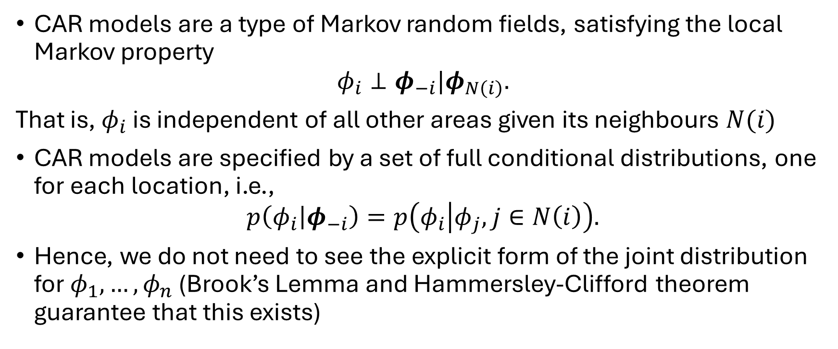
Conditional autoregressive models
CAR models are a type of Markov random fields, satisfying the local Markov property
$$φ_{i}⊥φ_{−i}|φ_{N\left(i\right)}.$$
That is, $φ_{i}$ is independent of all other areas given its neighbours $N(i)$
CAR models are specified by a set of full conditional distributions, one for each location, i.e.,
$$p\left(φ_{i} | φ_{−i}\right)=p\left(φ_{i} | φ_{j}, j∈N\left(i\right)\right).$$
Hence, we do not need to see the explicit form of the joint distribution for $φ_{1},…,φ_{n}$ (Brook’s Lemma and Hammersley-Clifford theorem guarantee that this exists)

Slide 15
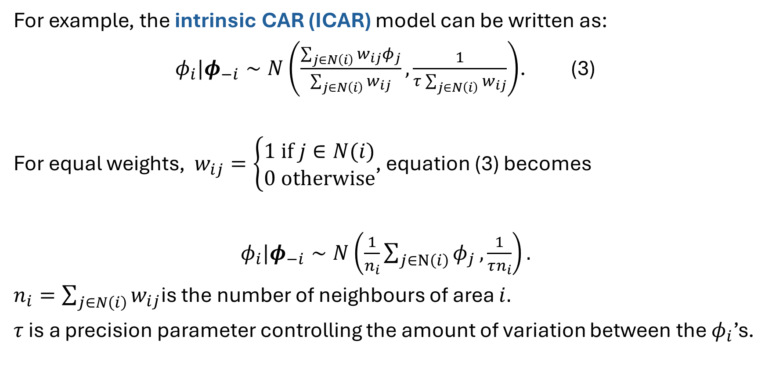
Conditional autoregressive models
For example, the intrinsic CAR (ICAR) model can be written as:
$φ_{i}|φ_{−i}∼N\left(\frac{\sum_{j∈N\left(i\right)}{w_{ij}φ_{j}}}{\sum_{j∈N\left(i\right)}{w_{ij}}},\frac{1}{τ\sum_{j∈N\left(i\right)}{w_{ij}}}\right)$. (3)
For equal weights, $w_{ij}=\left\{\begin{aligned}1 if j∈N(i) \\ 0 otherwise\end{aligned}\right.$, equation (3) becomes
$φ_{i}|φ_{−i}∼N\left(\frac{1}{n_{i}}\sum_{j∈N\left(i\right)}{φ_{j}},\frac{1}{τn_{i}}\right).$
$n_{i}=\sum_{j∈N\left(i\right)}{w_{ij}}$is the number of neighbours of area $i.$
$τ$ is a precision parameter controlling the amount of variation between the $φ_{i}$’s.
Interpretation: The conditional mean of an area's spatial effect is essentially the average of its neighbours' effects.

Slide 16
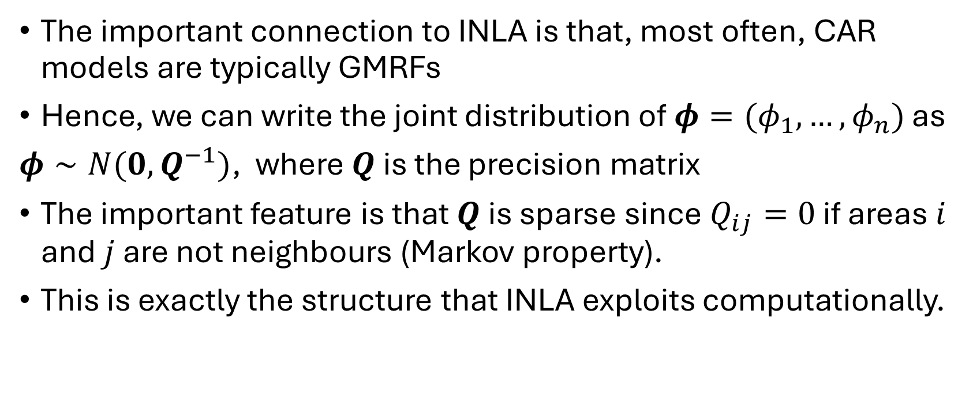
From CAR to a Gaussian Markov random field and INLA
The important connection to INLA is that, most often, CAR models are typically GMRFs
Hence, we can write the joint distribution of $φ=(φ_{1},…,φ_{n})$ as
$φ∼N(0, Q^{−1})$, where $Q$ is the precision matrix
The important feature is that $Q$ is sparse since $Q_{ij}=0$ if areas $i$ and $j$ are not neighbours (Markov property).
This is exactly the structure that INLA exploits computationally.

Slide 17
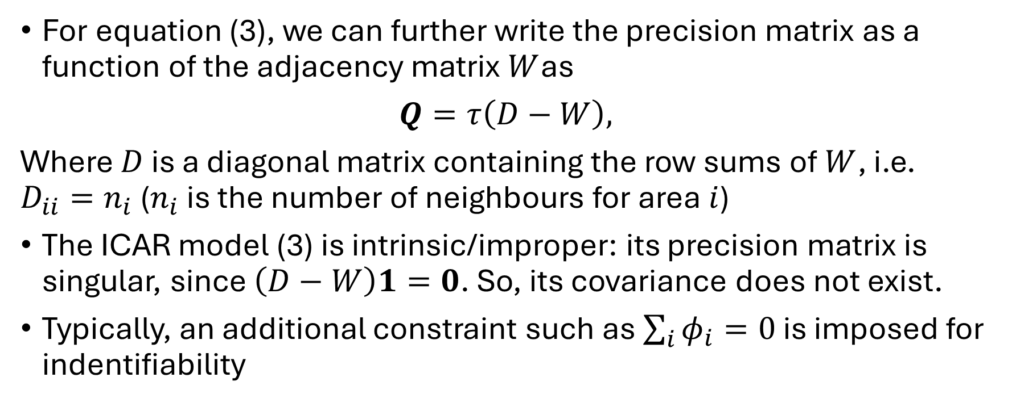
From CAR to a Gaussian Markov random field and INLA
For equation (3), we can further write the precision matrix as a function of the adjacency matrix $W$as
$Q=τ\left(D−W\right),$
Where $D$ is a diagonal matrix containing the row sums of $W$, i.e. $D_{ii}=n_{i}$ ($n_{i}$ is the number of neighbours for area $i$)
The ICAR model (3) is intrinsic/improper: its precision matrix is singular, since $\left(D−W\right)1=0$. So, its covariance does not exist.
Typically, an additional constraint such as $\sum_{i}{φ_{i}=0}$ is imposed for indentifiability

Slide 18
Other CAR models used in practice
The ICAR model is restrictive - it represents only strong spatial dependence and is inappropriate if data are only weakly correlated.
We will now consider some alternative CAR models that are more widely used in practice.

Slide 19
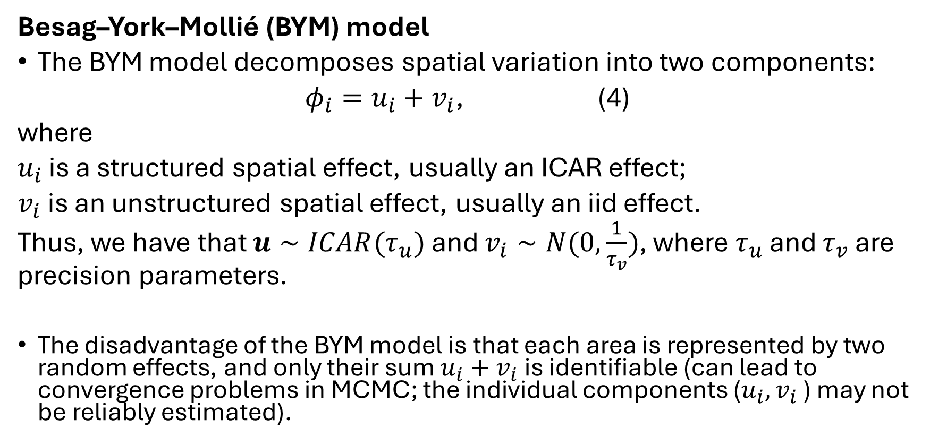
Other CAR models used in practice
Besag–York–Mollié (BYM) model
The BYM model decomposes spatial variation into two components:
$φ_{i}=u_{i}+v_{i}$, (4)
where
$u_{i}$ is a structured spatial effect, usually an ICAR effect;
$v_{i}$ is an unstructured spatial effect, usually an iid effect.
Thus, we have that $u∼ICAR(τ_{u})$ and $v_{i}∼N(0,\frac{1}{τ_{v}})$, where $τ_{u}$ and $τ_{v}$ are precision parameters.
The disadvantage of the BYM model is that each area is represented by two random effects, and only their sum $u_{i}+v_{i}$is identifiable (can lead to convergence problems in MCMC; the individual components ($u_{i}, v_{i}$) may not be reliably estimated).

Slide 20
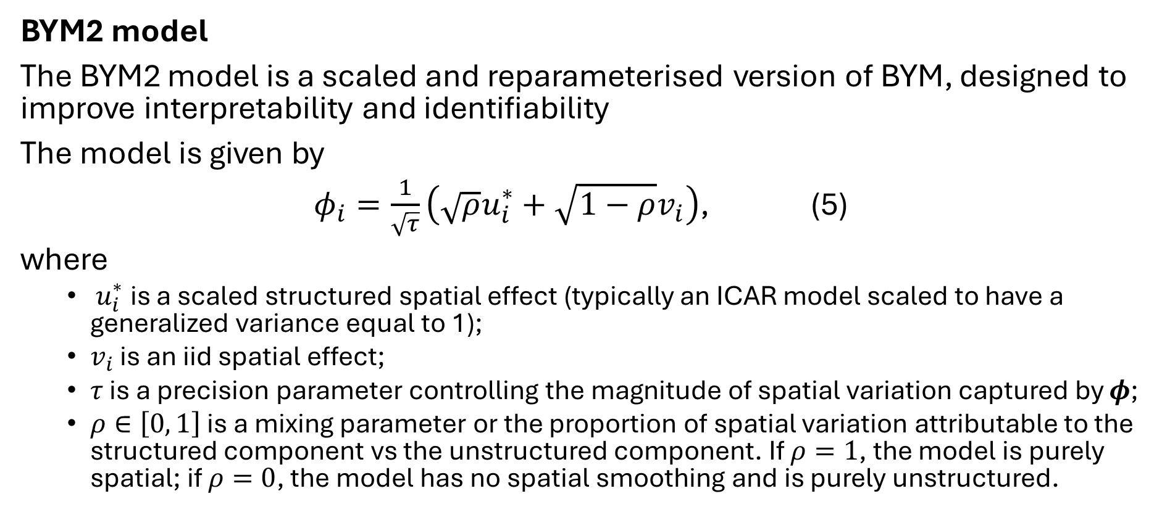
Other CAR models used in practice
BYM2 model
The BYM2 model is a scaled and reparameterised version of BYM, designed to improve interpretability and identifiability
The model is given by
$φ_{i}=\frac{1}{\sqrt{τ}}\left(\sqrt{ρ}u_{i}^{∗}+\sqrt{1−ρ}v_{i}\right)$, (5)
where
  ​ $u_{i}^{∗}$ is a scaled structured spatial effect (typically an ICAR model scaled to have a generalized variance equal to 1);
  $v_{i}$ is an iid spatial effect;
  $τ$ is a precision parameter controlling the magnitude of spatial variation captured by $φ$;
  $ρ∈\left[0 , 1\right]$ is a mixing parameter or the proportion of spatial variation attributable to the structured component vs the unstructured component. If $ρ=1$, the model is purely spatial; if $ρ=0$, the model has no spatial smoothing and is purely unstructured.

Slide 21
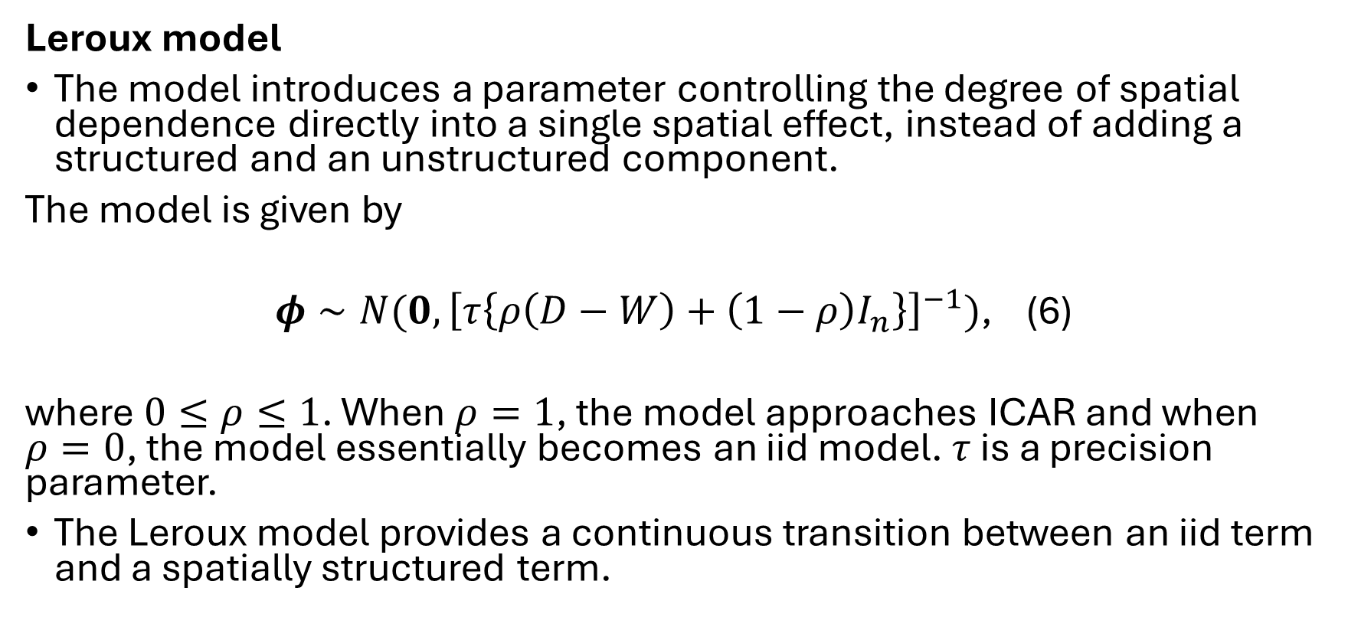
Other CAR models used in practice
Leroux model
The model introduces a parameter controlling the degree of spatial dependence directly into a single spatial effect, instead of adding a structured and an unstructured component.
The model is given by
$φ∼N(0, {\left[τ\left\{ρ\left(D−W\right)+\left(1−ρ\right)I_{n}\right\}\right]}^{−1})$, (6)
where $0≤ρ≤1$. When $ρ=1$, the model approaches ICAR and when $ρ=0$, the model essentially becomes an iid model. $τ$ is a precision parameter.
The Leroux model provides a continuous transition between an iid term and a spatially structured term.

Slide 22
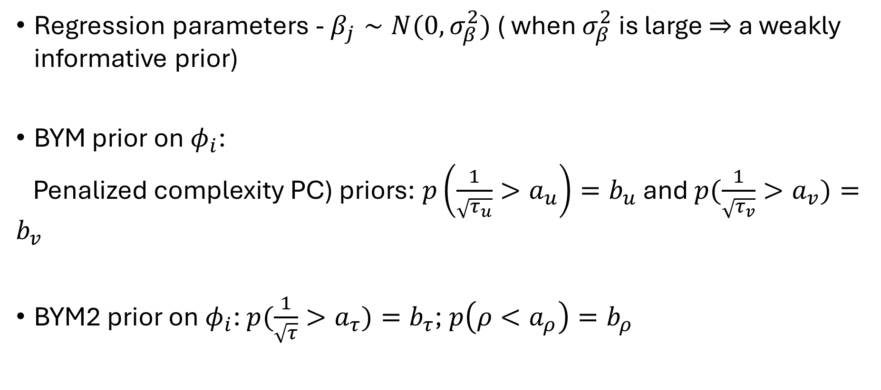
Choosing priors for the parameters
Regression parameters - $β_{j}∼N(0, σ_{β}^{2})$ ( when $σ_{β}^{2}$ is large $⇒$ a weakly informative prior)
BYM prior on $φ_{i}$:
Penalized complexity PC) priors: $p\left(\frac{1}{\sqrt{τ_{u}}}>a_{u}\right)=b_{u}$ and $p(\frac{1}{\sqrt{τ_{v}}}>a_{v})=b_{v}$
BYM2 prior on $φ_{i}$: $p(\frac{1}{\sqrt{τ}}>a_{τ})=b_{τ}$;$p\left(ρ<a_{ρ}\right)=b_{ρ}$

Slide 23

Choosing priors for the parameters
Leroux prior on $φ_{i}$:
$p(\frac{1}{\sqrt{τ}}>a_{τ})=b_{τ}$;$p\left(ρ<a_{ρ}\right)=b_{ρ}$
(e.g., in the BYM2 model, we could choose $a_{τ}=1, b_{τ}=0.01,a_{ρ}=0.5,b_{ρ}=0.01$)

Slide 24
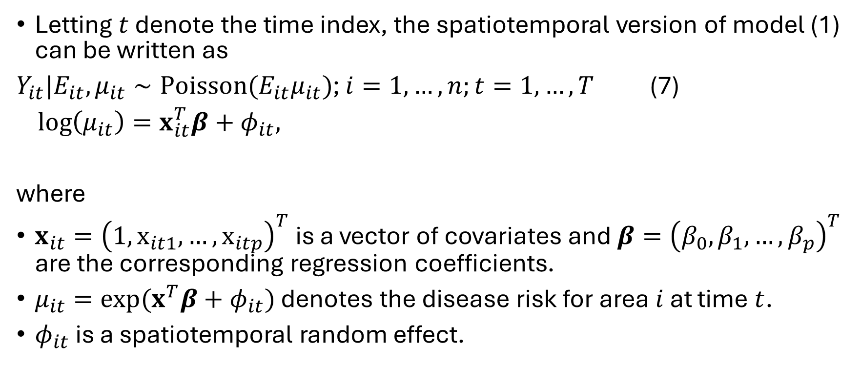
Spatiotemporal CAR model
Letting $t$ denote the time index, the spatiotemporal version of model (1) can be written as
$Y_{it}|E_{it},μ_{it}∼Poisson(E_{it}μ_{it})$; $i=1,…,n;t=1,…,T$ (7)
$\log\left(μ_{it}\right)=x_{it}^{T}β+φ_{it},$
where
$x_{it}={\left(1,x_{it1},…,x_{itp}\right)}^{T}$ is a vector of covariates and $β={\left(β_{0},β_{1},…,β_{p}\right)}^{T}$ are the corresponding regression coefficients.
$μ_{it}=exp⁡(x^{T}β+φ_{it})$ denotes the disease risk for area $i$ at time $t$.
$φ_{it}$ is a spatiotemporal random effect.

Slide 25
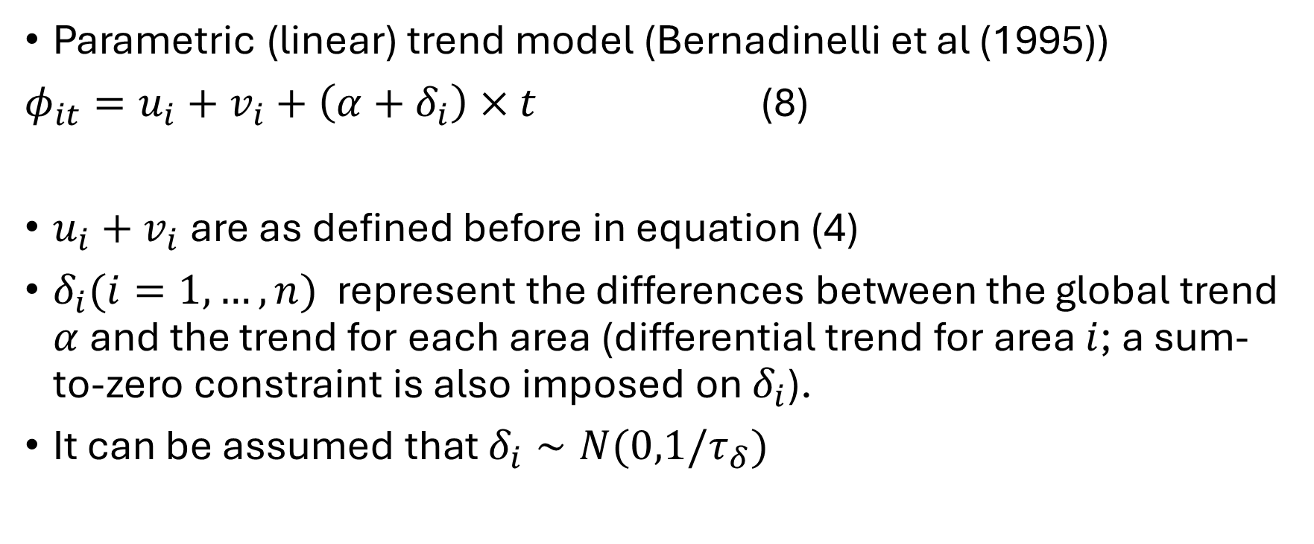

Modelling $φ_{it}$
Parametric (linear) trend model (Bernadinelli et al (1995))
$φ_{it}=u_{i}+v_{i}+\left(α+δ_{i}\right)×t$ (8)
$u_{i}+v_{i}$ are as defined before in equation (4)
$δ_{i}(i=1,…,n)$ represent the differences between the global trend $α$ and the trend for each area (differential trend for area $i$; a sum-to-zero constraint is also imposed on $δ_{i}$).
It can be assumed that $δ_{i}∼N(0,1/τ_{δ})$

Slide 26
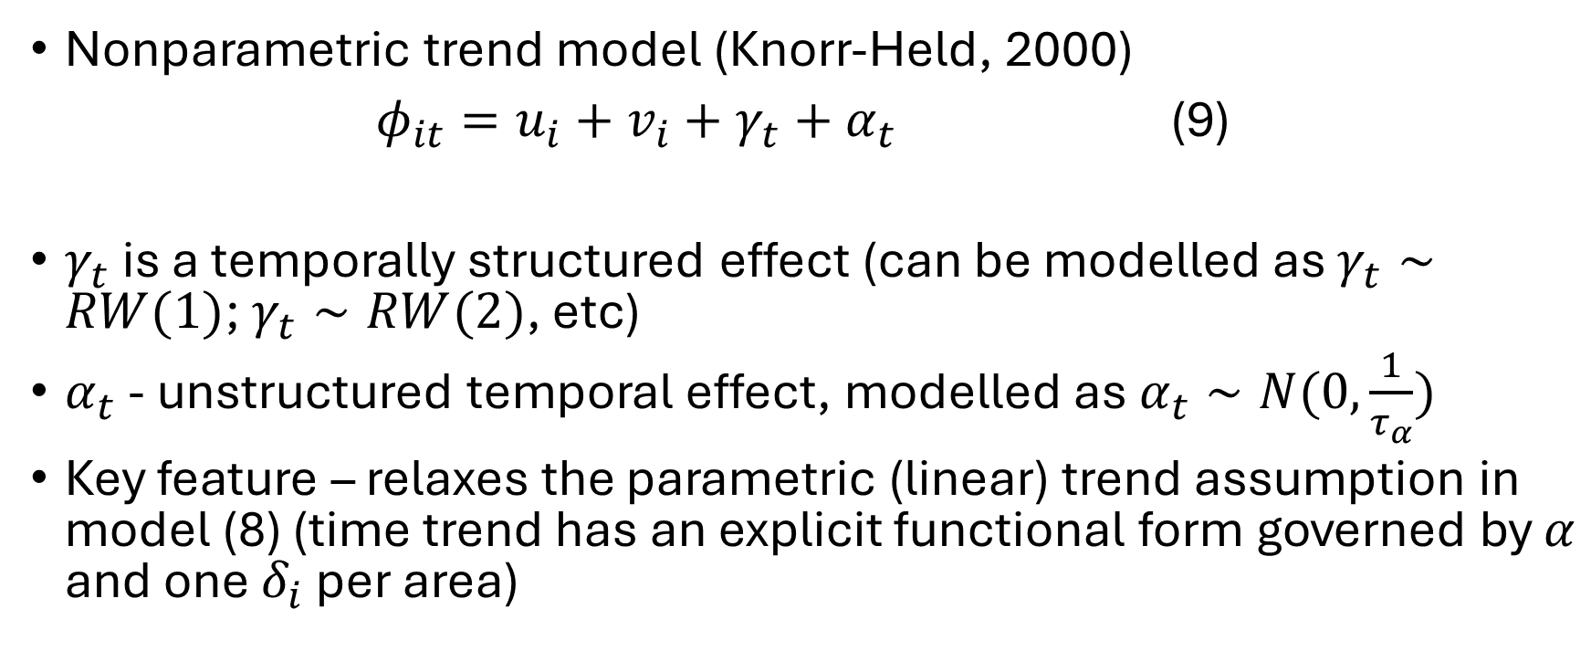
Modelling $φ_{it}$
Nonparametric trend model (Knorr-Held, 2000)
$φ_{it}=u_{i}+v_{i}+γ_{t}+α_{t}$ (9)
$γ_{t}$ is a temporally structured effect (can be modelled as $γ_{t}∼RW(1)$; $γ_{t}∼RW(2)$, etc)
$α_{t}$ - unstructured temporal effect, modelled as $α_{t}∼N(0,\frac{1}{τ_{α}})$
Key feature – relaxes the parametric (linear) trend assumption in model (8) (time trend has an explicit functional form governed by $α$ and one $δ_{i}$ per area)

Slide 27
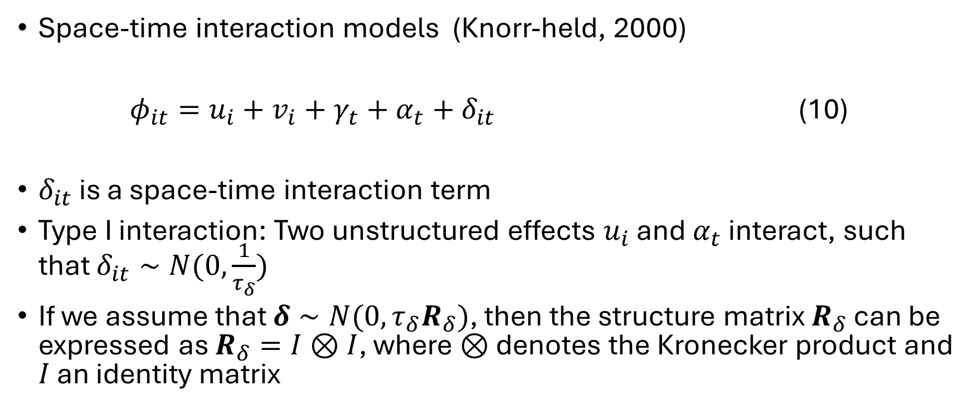
Modelling $φ_{it}$ - space-time interaction models
Unstructured terms
Structured terms
Space-time interaction models (Knorr-held, 2000)
$φ_{it}=u_{i}+v_{i}+γ_{t}+α_{t}+δ_{it}$ (10)
$δ_{it}$ is a space-time interaction term
Type I interaction: Two unstructured effects $u_{i}$ and $α_{t}$ interact, such that $δ_{it}∼N(0,\frac{1}{τ_{δ}})$
If we assume that $δ∼N(0,τ_{δ}R_{δ})$, then the structure matrix $R_{δ}$ can be expressed as $R_{δ}=I⊗I$, where $⊗$ denotes the Kronecker product and $I$ an identity matrix

Slide 28
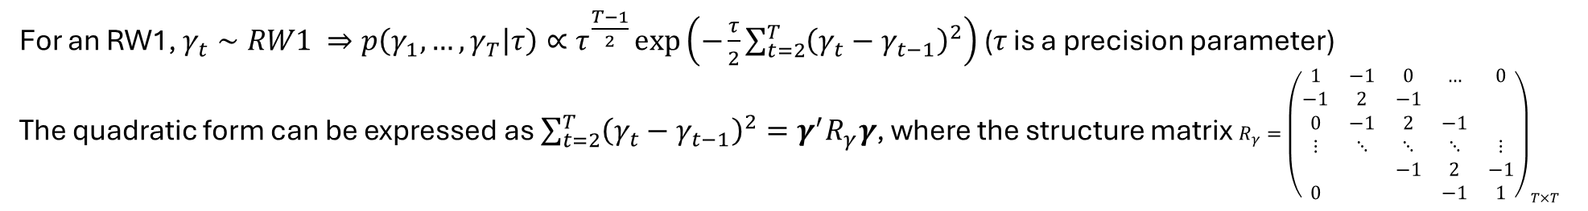
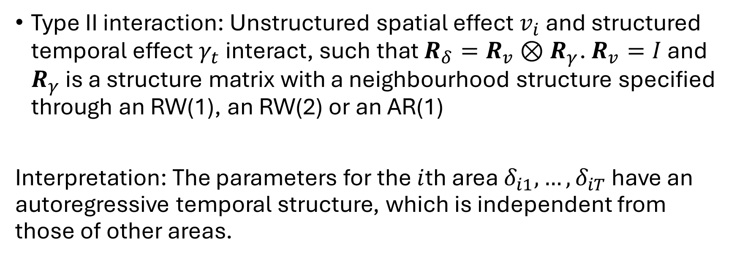
Modelling $φ_{it}$ - space-time interaction models
Type II interaction: Unstructured spatial effect $v_{i}$ and structured temporal effect $γ_{t}$ interact, such that $R_{δ}=R_{v}⊗R_{γ}$. $R_{v}=I$ and $R_{γ}$ is a structure matrix with a neighbourhood structure specified through an RW(1), an RW(2) or an AR(1)
Interpretation: The parameters for the $i$th area $δ_{i1},…,δ_{iT}$ have an autoregressive temporal structure, which is independent from those of other areas.
For an RW1, $γ_{t}∼RW1 ⇒p\left(γ_{1},…,γ_{T} | τ\right)∝τ^{\frac{T−1}{2}}\exp\left(−\frac{τ}{2}\sum_{t=2}^{T}{{\left(γ_{t}−γ_{t−1}\right)}^{2}}\right)$ ($τ$ is a precision parameter)
The quadratic form can be expressed as $\sum_{t=2}^{T}{{\left(γ_{t}−γ_{t−1}\right)}^{2}}=γ^{′}R_{γ}γ$, where the structure matrix $R_{γ}={\left(\begin{matrix}1 & −1 & 0 & … & 0 \\ −1 & 2 & −1 & & \\ 0 & −1 & 2 & −1 & \\ ⋮ & ⋱ & ⋱ & ⋱ & ⋮ \\ & & −1 & 2 & −1 \\ 0 & & & −1 & 1\end{matrix}\right)}_{T×T}$

Slide 29
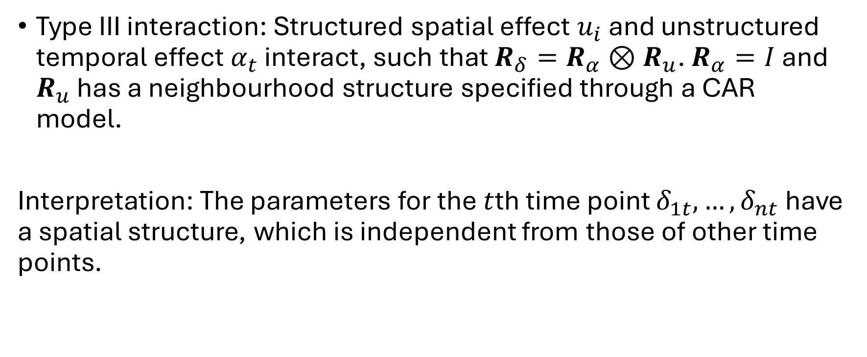
Modelling $φ_{it}$ - space-time interaction models
Type III interaction: Structured spatial effect $u_{i}$ and unstructured temporal effect $α_{t}$ interact, such that $R_{δ}=R_{α}⊗R_{u}$. $R_{α}=I$ and $R_{u}$ has a neighbourhood structure specified through a CAR model.
Interpretation: The parameters for the $t$th time point $δ_{1t},…,δ_{nt}$ have a spatial structure, which is independent from those of other time points.

Slide 30
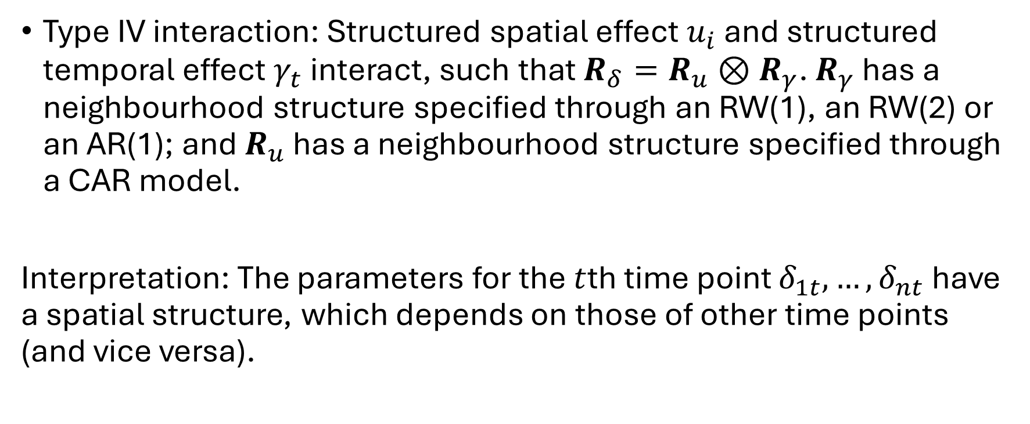
Modelling $φ_{it}$ - space-time interaction models
Type IV interaction: Structured spatial effect $u_{i}$ and structured temporal effect $γ_{t}$ interact, such that $R_{δ}=R_{u}⊗R_{γ}$. $R_{γ}$ has a neighbourhood structure specified through an RW(1), an RW(2) or an AR(1); and $R_{u}$ has a neighbourhood structure specified through a CAR model.
Interpretation: The parameters for the $t$th time point $δ_{1t},…,δ_{nt}$ have a spatial structure, which depends on those of other time points (and vice versa).

Slide 31
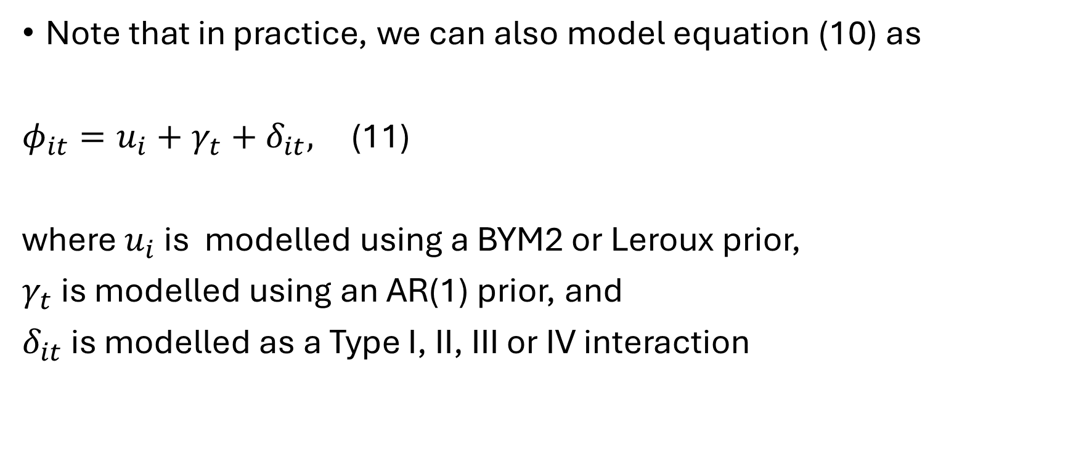
Modelling $φ_{it}$ - space-time interaction models
Note that in practice, we can also model equation (10) as
$φ_{it}=u_{i}+γ_{t}+δ_{it},$ (11)
where $u_{i}$ is modelled using a BYM2 or Leroux prior,
$γ_{t}$ is modelled using an AR(1) prior, and
$δ_{it}$ is modelled as a Type I, II, III or IV interaction

Slide 32
Exploratory data analysis for areal data
Before undertaking spatial (or spatiotemporal) analysis of areal data, if we are unsure about the presence of spatial (or spatiotemporal) autocorrelation in the data, we can test this in two ways:
  Fit a non-spatial GLM with an IID random effect for area, and then use the estimates of the random effect to test for the presence of spatial autocorrelation (for LMs, we can obtain the residuals directly)
  Apply relevant tests to the outcome variable to ascertain whether the data are spatially correlated (useful when covariates are not included in the analysis)
These tests can also be applied to residuals from spatial/ spatiotemporal analyses as part of residual analysis
We will now examine some tests that can reveal the presence of spatial autocorrelation, either in the data or the residuals from a model

Slide 33
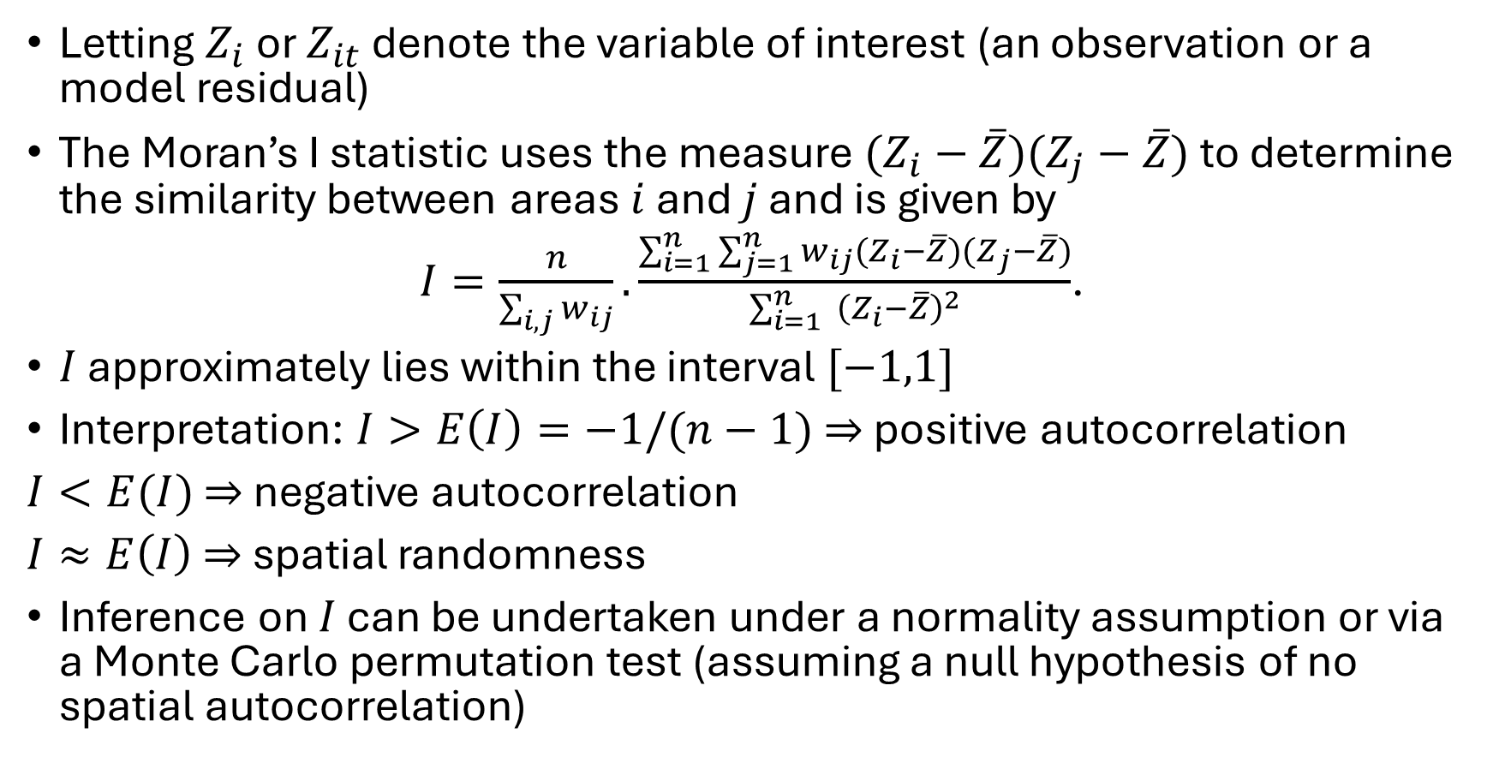
Global Moran’s I
Letting $Z_{i}$ or $Z_{it}$ denote the variable of interest (an observation or a model residual)
The Moran’s I statistic uses the measure $(Z_{i}−\overline{Z})(Z_{j}−\overline{Z})$ to determine the similarity between areas $i$ and $j$ and is given by
$I=\frac{n}{\sum_{i,j}{w_{ij}}}.\frac{\sum_{i=1}^{n}{\sum_{j=1}^{n}{w_{ij}(Z_{i}−\overline{Z})(Z_{j}−\overline{Z})}}}{\sum_{i=1}^{n}{ {\left(Z_{i}−\overline{Z}\right)}^{2}}}$.
$I$ approximately lies within the interval $[−1,1]$
Interpretation: $I>E\left(I\right)=−1/(n−1)$ $⇒$ positive autocorrelation
$I<E(I)$ $⇒$ negative autocorrelation
$I≈E\left(I\right)$ $⇒$ spatial randomness
Inference on $I$ can be undertaken under a normality assumption or via a Monte Carlo permutation test (assuming a null hypothesis of no spatial autocorrelation)

Slide 34
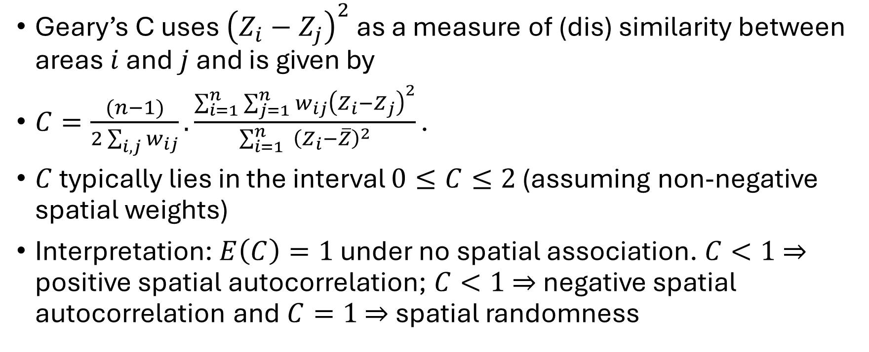
Geary’s C
Geary’s C uses ${\left(Z_{i}−Z_{j}\right)}^{2}$ as a measure of (dis) similarity between areas $i$ and $j$ and is given by
$C=\frac{(n−1)}{2\sum_{i,j}{w_{ij}}}.\frac{\sum_{i=1}^{n}{\sum_{j=1}^{n}{w_{ij}{\left(Z_{i}−Z_{j}\right)}^{2}}}}{\sum_{i=1}^{n}{ {\left(Z_{i}−\overline{Z}\right)}^{2}}}\text{.}$
$C$ typically lies in the interval $0≤C≤2$ (assuming non-negative spatial weights)
Interpretation: $E\left(C\right)=1$ under no spatial association. $C<1$ $⇒$ positive spatial autocorrelation; $C<1$ $⇒$ negative spatial autocorrelation and$C=1$ $⇒$ spatial randomness

Slide 35
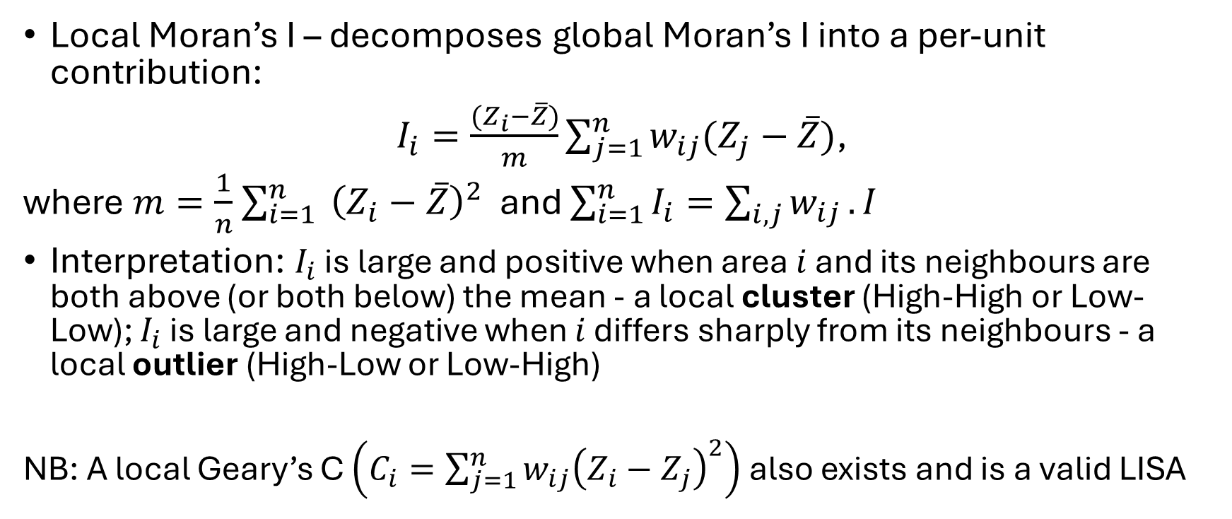
Local indicators of spatial association (LISA)
Local Moran’s I – decomposes global Moran’s I into a per-unit contribution:
$I_{i}=\frac{(Z_{i}−\overline{Z})}{m}\sum_{j=1}^{n}{w_{ij}(Z_{j}−\overline{Z})}$,
where $m=\frac{1}{n}$ $\sum_{i=1}^{n}{ {\left(Z_{i}−\overline{Z}\right)}^{2}}$ and $\sum_{i=1}^{n}{I_{i}}=\sum_{i,j}{w_{ij}}.I$
Interpretation: $I_{i}$ is large and positive when area $i$ and its neighbours are both above (or both below) the mean - a local cluster (High-High or Low-Low); $I_{i}$ is large and negative when $i$ differs sharply from its neighbours - a local outlier (High-Low or Low-High)
NB: A local Geary’s C $\left(C_{i}=\sum_{j=1}^{n}{w_{ij}{\left(Z_{i}−Z_{j}\right)}^{2}}\right)$ also exists and is a valid LISA

Slide 36
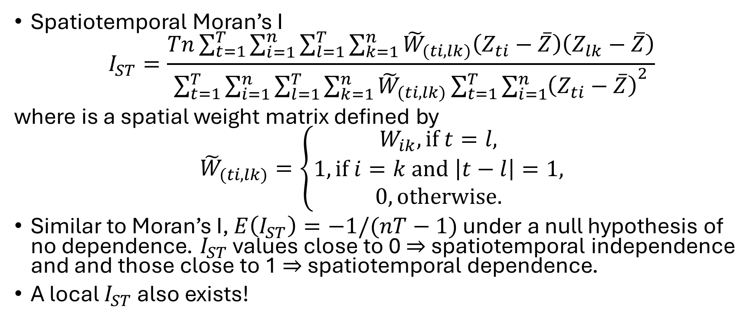
Spatiotemporal Moran’s I
Matrix notation can be better
Spatiotemporal Moran’s I
$$I_{ST}=\frac{Tn\sum_{t=1}^{T}{\sum_{i=1}^{n}{\sum_{l=1}^{T}{\sum_{k=1}^{n}{{\tilde{W}}_{(ti,lk)}\left(Z_{ti}−\overline{Z}\right)\left(Z_{lk}−\overline{Z}\right)}}}}}{\sum_{t=1}^{T}{\sum_{i=1}^{n}{\sum_{l=1}^{T}{\sum_{k=1}^{n}{{\tilde{W}}_{(ti,lk)}{\sum_{t=1}^{T}{\sum_{i=1}^{n}{\left(Z_{ti}−\overline{Z}\right)}}}^{2}}}}}}$$
where is a spatial weight matrix defined by
$${\tilde{W}}_{(ti,lk)}=\left\{\begin{aligned}W_{ik}, if t=l, \\ 1, if i=k and \left|t−l\right|=1, \\ 0, otherwise.\end{aligned}\right.$$
Similar to Moran’s I, $E\left(I_{ST}\right)=−1/(nT−1)$ under a null hypothesis of no dependence. $I_{ST}$ values close to 0 $⇒$ spatiotemporal independence and and those close to 1 $⇒$ spatiotemporal dependence.
A local $I_{ST}$ also exists!

Slide 37
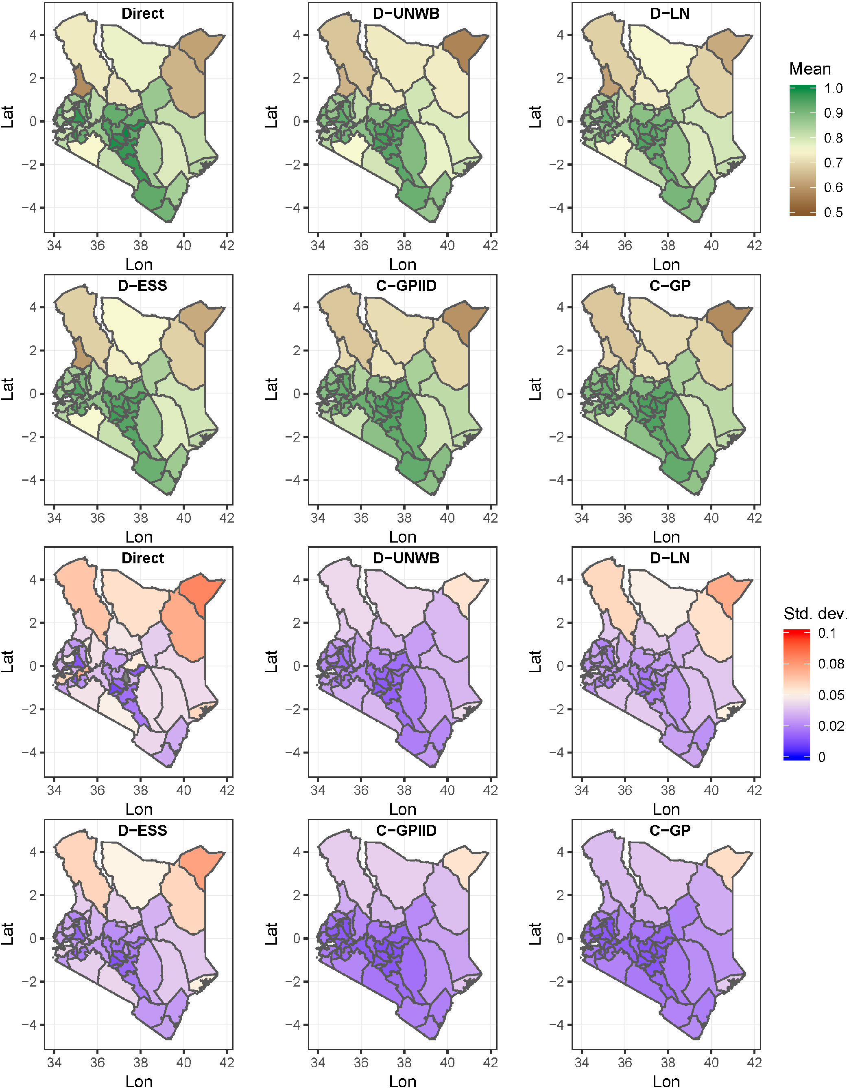
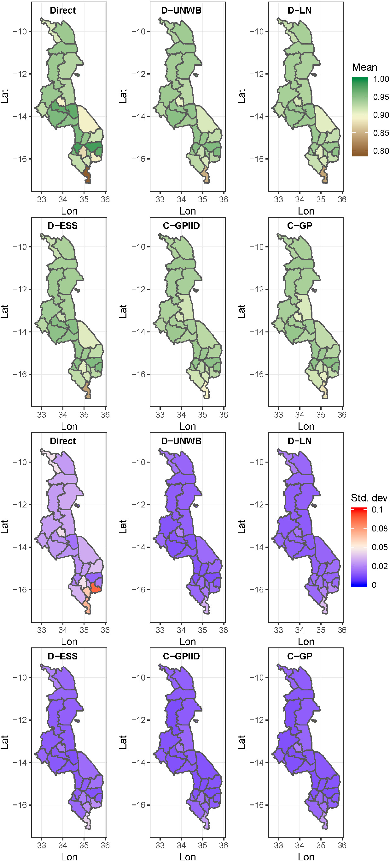
Example output maps
MCV1
DTP3
Source: https://onlinelibrary.wiley.com/doi/10.1002/sim.8897

Slide 38
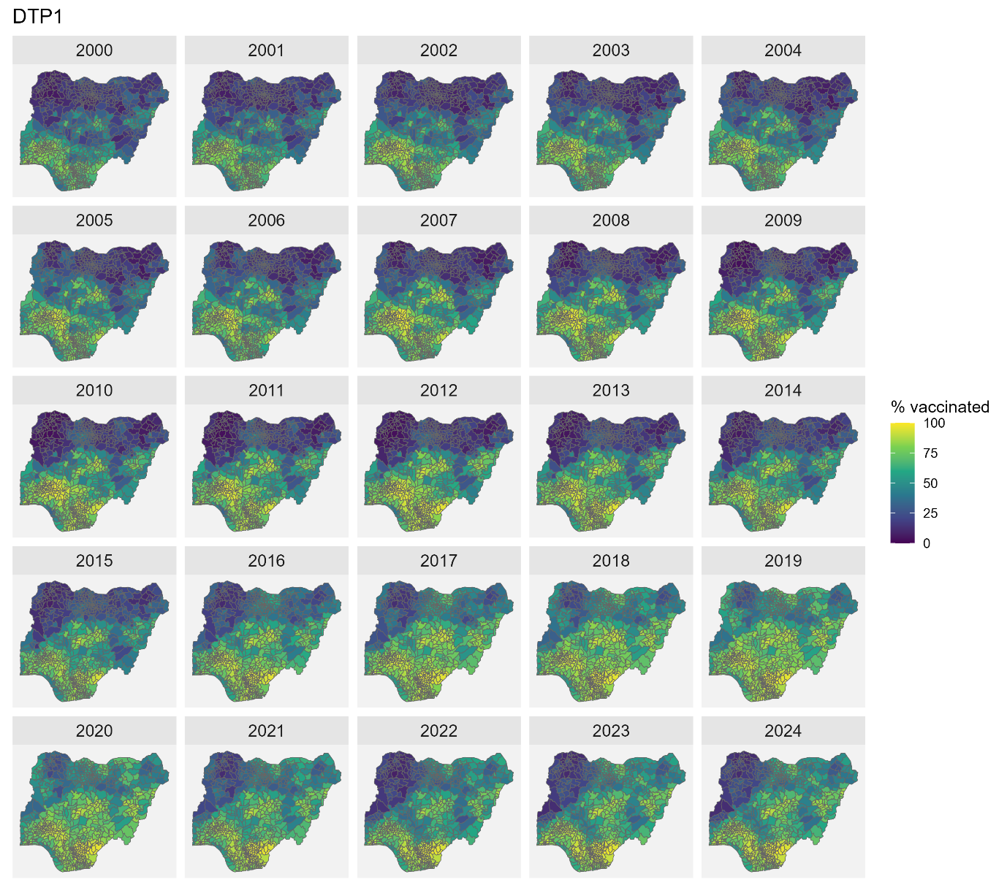
Example output maps
Source: https://www.medrxiv.org/content/10.64898/2026.01.19.26344414v1

Slide 39
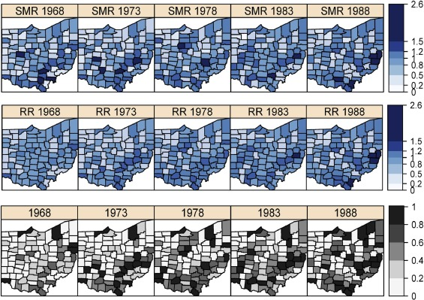
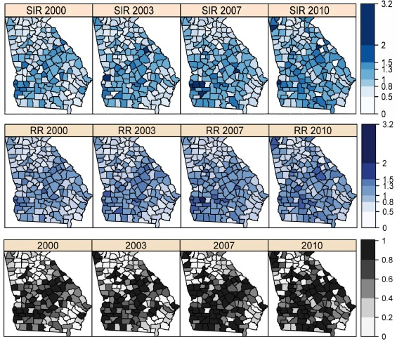
Example output maps
Ohio lung cancer mortality
Georgia low birth weight data

Slide 40
Exercise 3
In this exercise, you will practice spatial areal data analysis. The data for the exercise are available in the SpatialEpi package in R. You will need to load all the required packages before you run the code.
The Scottish lip cancer data contains information on male lip cancer cases recorded across 56 Scottish counties during 1975–1980, together with expected cases, geographical boundaries and the proportion of the workforce employed in agriculture, fishing and forestry. The data provide a classic example for demonstrating spatial variation in disease risk and Bayesian areal disease-mapping models.
You will also practice producing interactive visualizations using the outputs generated from your analysis.

Slide 41
Exercise 4
In this exercise, you will practice spatiotemporal areal data analysis.
The data for the analysis relates to lung cancer deaths in 𝑛=88 counties of Ohio, USA, for the years 1968 to 1988. This dataset was originally analyzed by Devine (1992) but has since been analysed by many other authors. The version used here was obtained from Blangiardo and Cameletti (2015).
Here, you will learn how to use R-INLA to fit the spatiotemporal models discussed in this session.

Slide 42
References
Banerjee, S., Gelfand, A. E., & Carlin, B. P. (2025). Hierarchical modeling and analysis for spatial data (3rd ed.). Chapman and Hall/CRC.
Blangiardo, M., & Cameletti, M. (2015). Spatial and spatio-temporal Bayesian models in R-INLA, John Wiley & Sons
Devine O.J. Empirical Bayes and constrained empirical Bayes methods for estimating incidence rates in spatially aligned areas. Unpublished Ph.D. thesis, Department of Biostatistics, Emory University1992
Sahu, S. K. (2022). Bayesian modelling of spatio-temporal data with R. Chapman and Hall/CRC.
Schabenberger, O., & Gotway, C. A. (2005). Statistical methods for spatial data analysis. Chapman & Hall/CRC.
Zuur, A. F., Ieno, E. N., & Saveliev, A. A. (2017). Beginner's Guide to Spatial, Temporal and Spatial-Temporal Ecological Data Analysis with R-INLA: Volume I: Using GLM and GLMM. Newburgh, UK: Highland Statistics Ltd.

